Slide 1
Chapter 2
Project Integration and Scope management

Slide 2
Project Integration Management
It involves coordinating all the project management knowledge areas throughout a project’s life span.
It is the project manager’s job to lead project integration management and keep an overall view of the project to ensure its success.

Slide 3
Project Management Plans
It is a document used to integrate and coordinate all project planning documents and to help guide a project’s execution, monitoring and control and closure.
It facilitates communication among stakeholders and provides a baseline for progress measurement and project control.
The main benefit of the process to create a project management plan is a comprehensive document that defines the basic of all project work and how it will be performed.

Slide 4
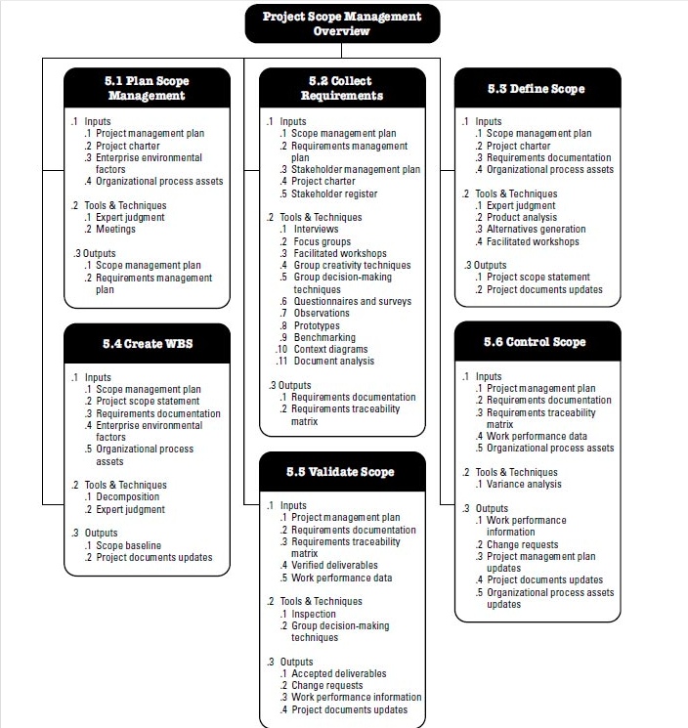

Slide 5
Controlling Scope
You can not control the scope of a project unless you have first clearly defined the scope and set a scope validation process in place.
You also need to develop a process for soliciting and monitoring changes to project scope.
Stakeholder should be encouraged to suggest beneficial change and discouraged from suggesting unnecessary changes.
The output of controlling scopes are:-
Work performance information
Change requests
Project management plans updates
Project document updates.

